Slide 1

ELECTROSTATICS

Slide 2
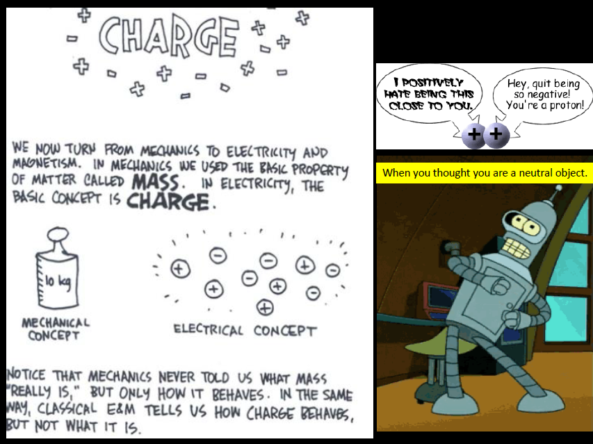

Slide 3
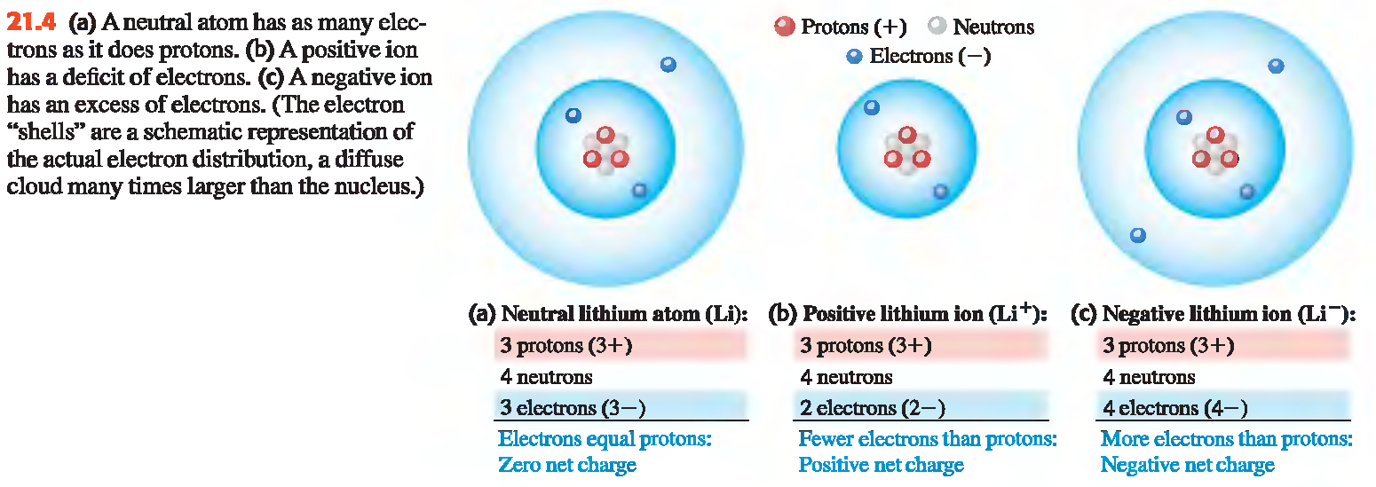
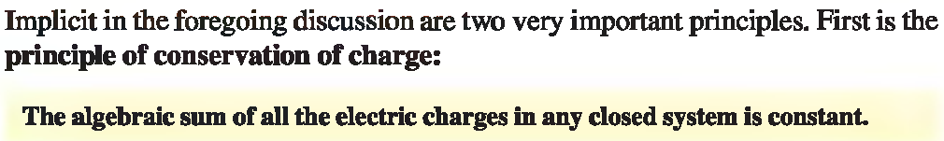
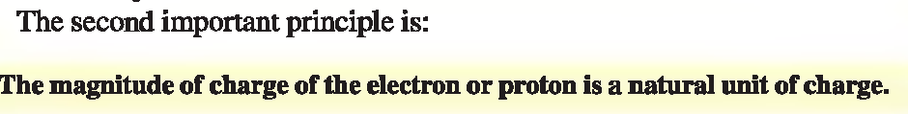
ELECTRIC CHARGE

Slide 4
1- A baseball is thrown from the roof of a 22.0 m tall building with an initial velocity of magnitude 12.0 m/s and directed at an angle of 53.1º above the horizontal.
What is the speed of the ball just before it strikes the ground? What will be the speed of the ball just before it strikes the ground if it is directed at an angle of 53.1º below the horizontal?
2- For a satellite to be in a circular orbit 800 km above the surface of earth (a) What orbital speed must it be given and (b) what is the period of the orbit (in hours)
G=6.67x10⁻¹¹ Nm²/kg² Mass of sun = M= 1.989x10³⁰ kg Mass of earth =Me = 5.98x10²⁴ kg Radius of earth = Re= 6.38x10⁶ m | K= 9 x 10⁹ Nm²/c² Ɛ_{o} = 8.85 x 10⁻¹² farad per meter (F/m) e = 1.6 × 10⁻¹⁹ coulombs g= 9.8 m/s²

Slide 5
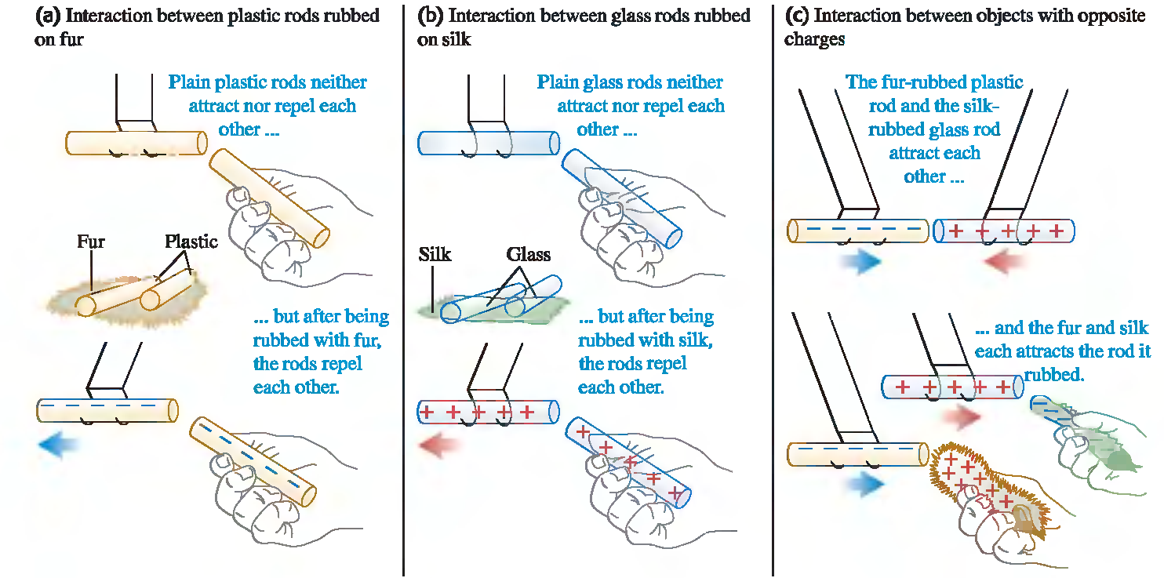
CHARGING AN INSULATOR BY FRICTION

Slide 6
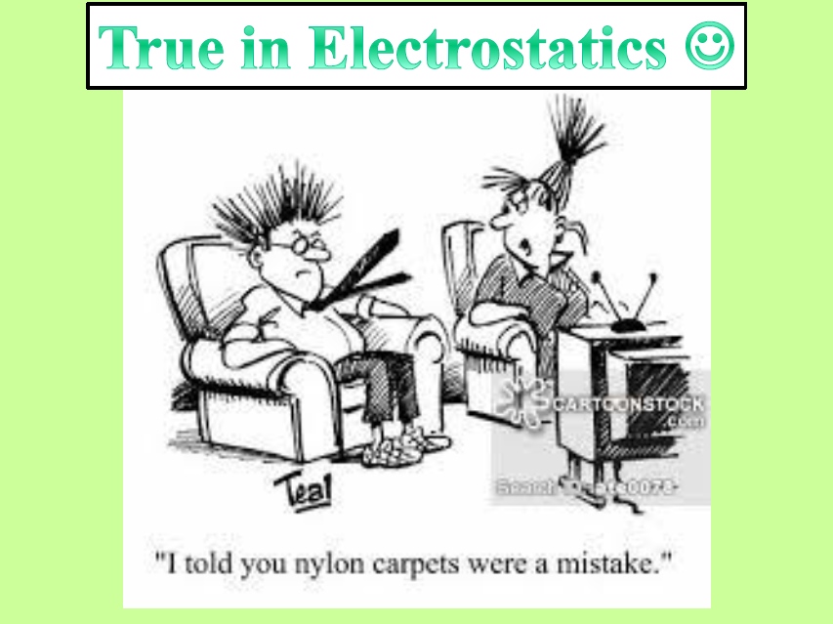

Slide 7
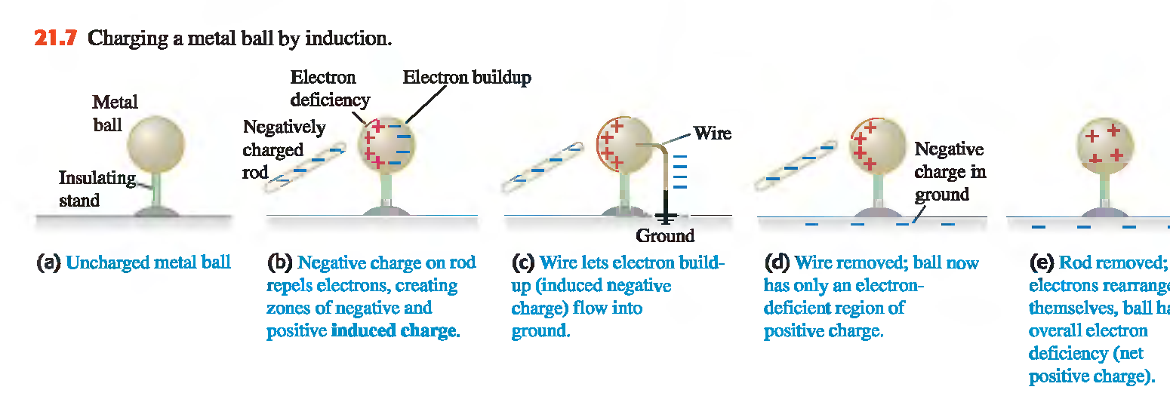
CHARGING A CONDUCTOR BY INDUCTION

Slide 8
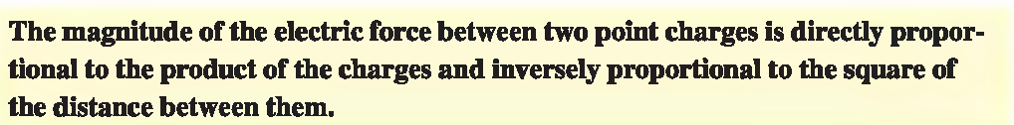
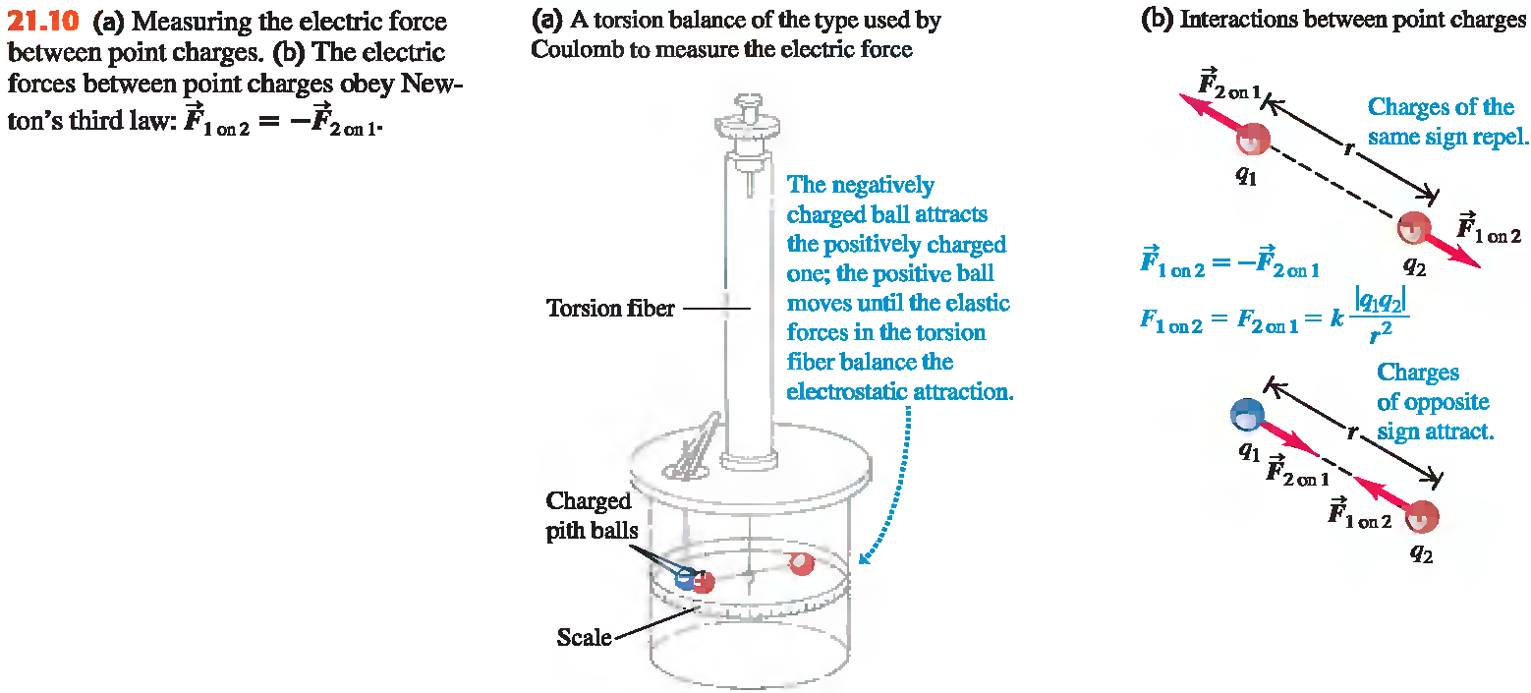
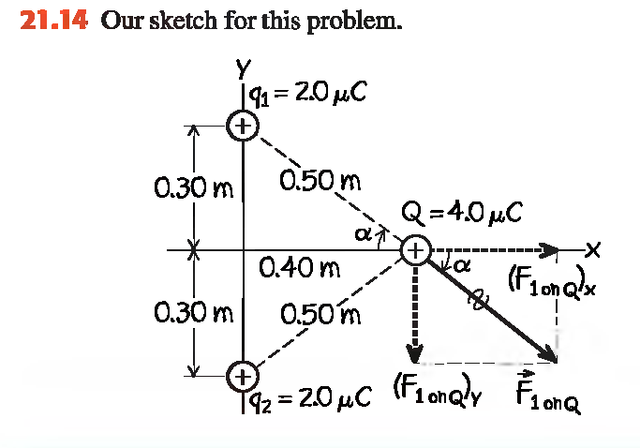
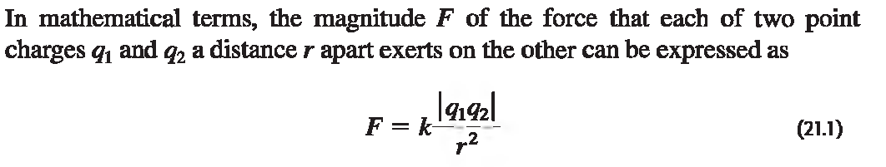
COULOMB'S LAW

Slide 9

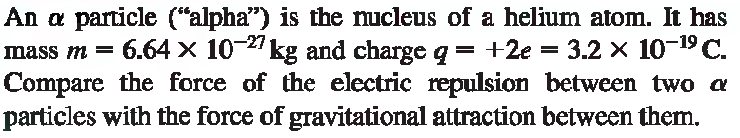
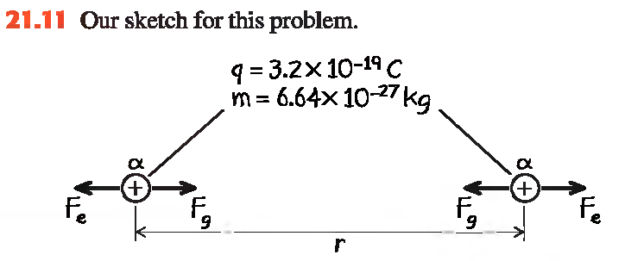

Slide 10

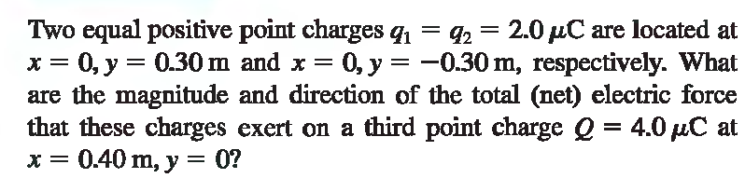

Slide 11
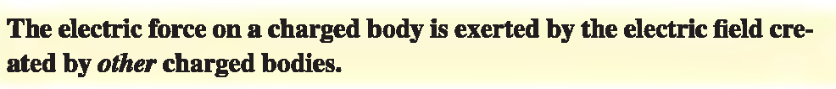
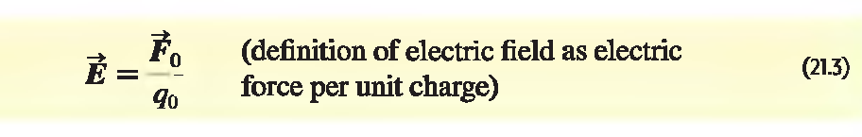

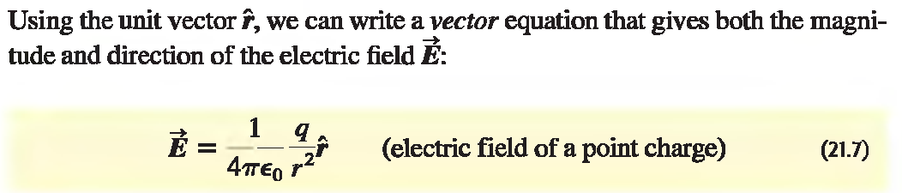
ELECTRIC FIELD

Slide 12
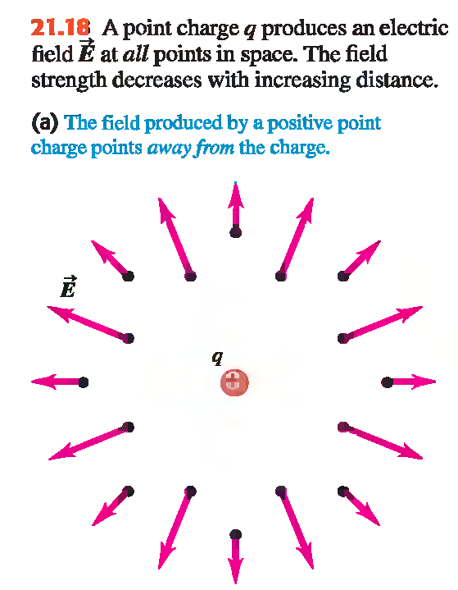
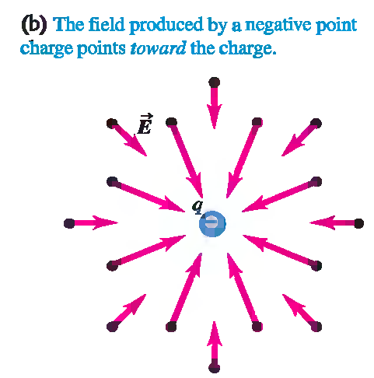
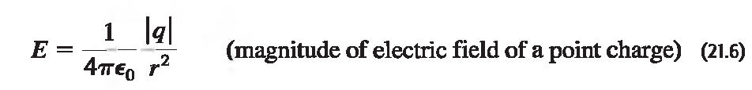


Slide 13

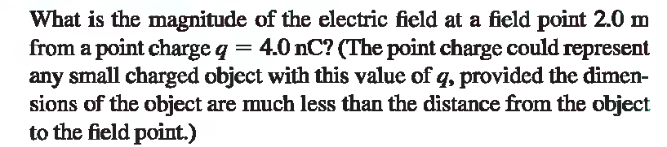
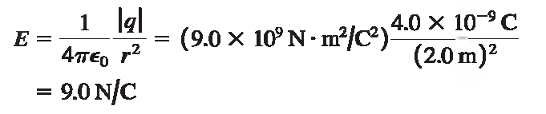

Slide 14

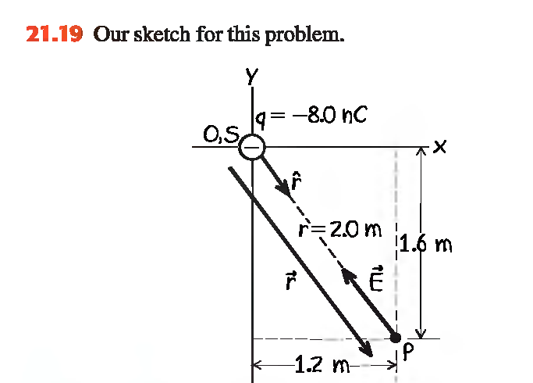

Slide 15



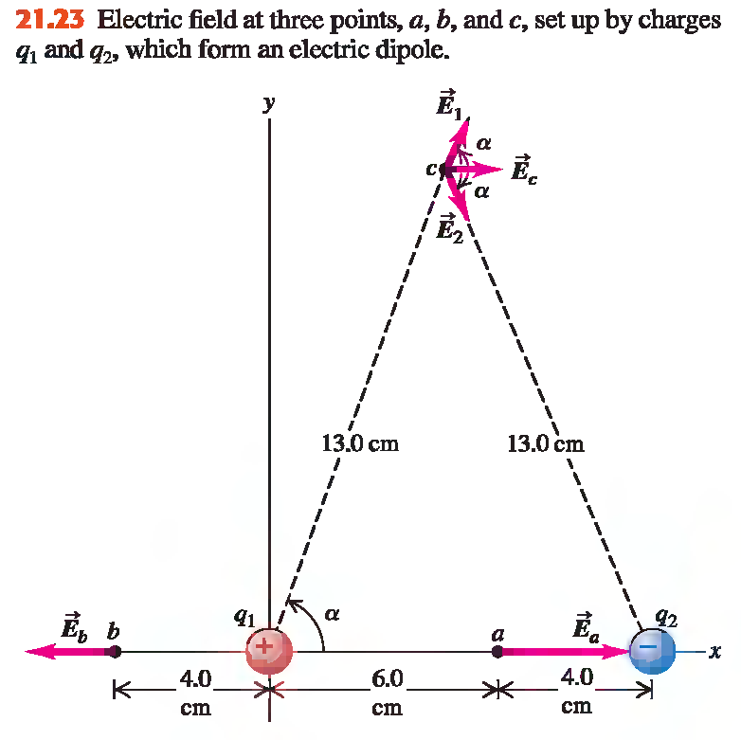

Slide 16
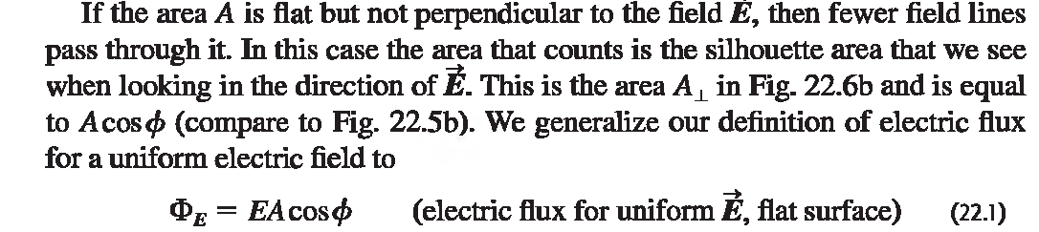
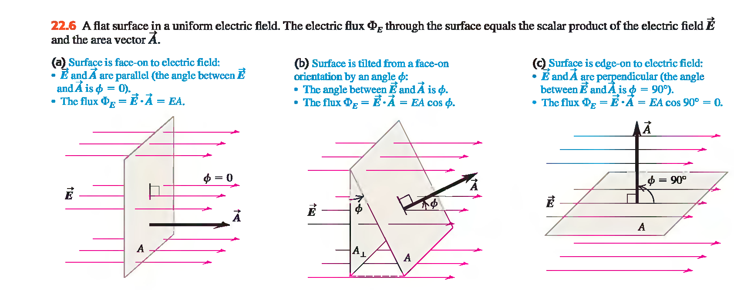
ELECTRIC FLUX

Slide 17
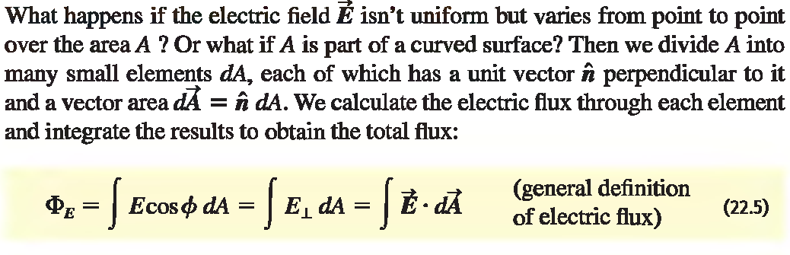
FLUX OF A NON-UNIFORM ELECTRIC FIELD

Slide 18

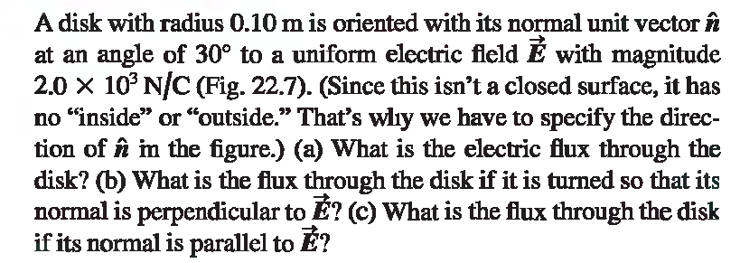
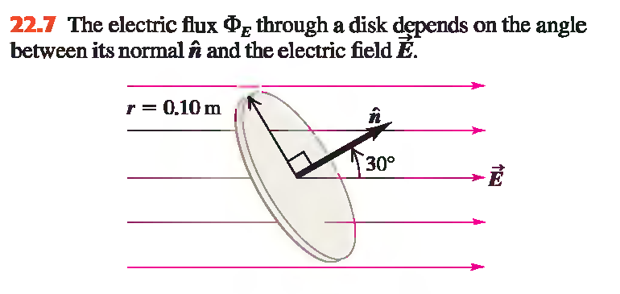


Slide 19

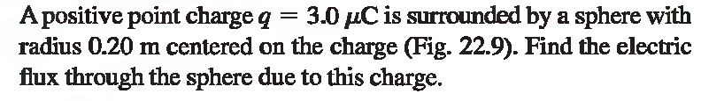
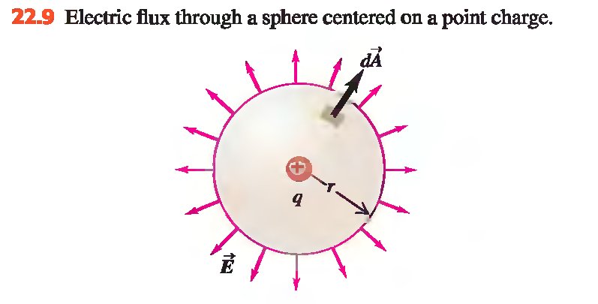


Slide 20
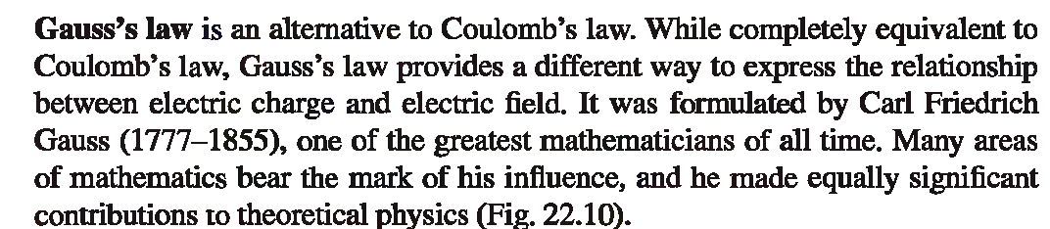
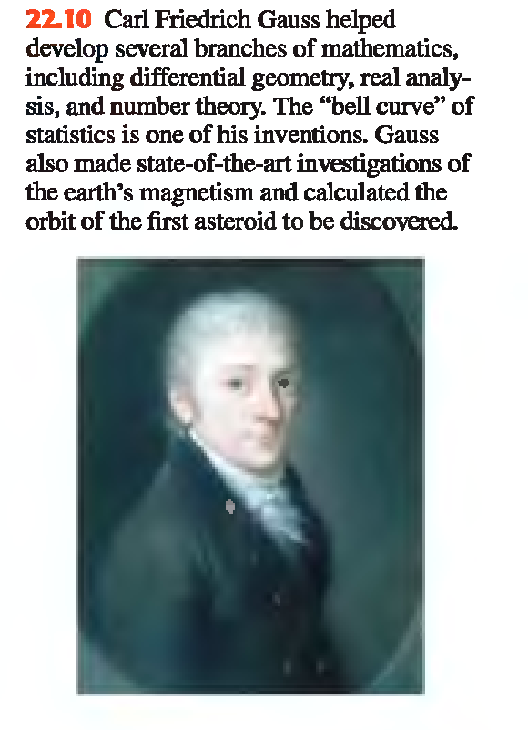

GAUSS'S LAW

Slide 21
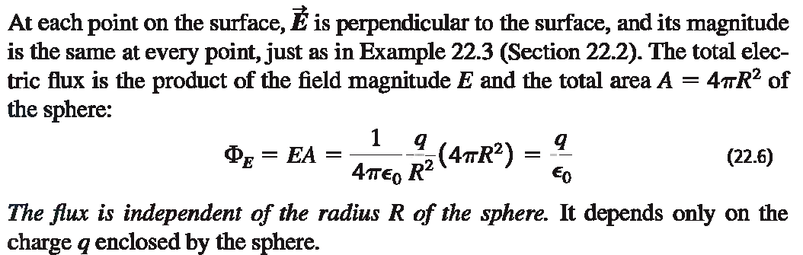
POINT CHARGE INSIDE A SPHERICAL SURFACE

Slide 22
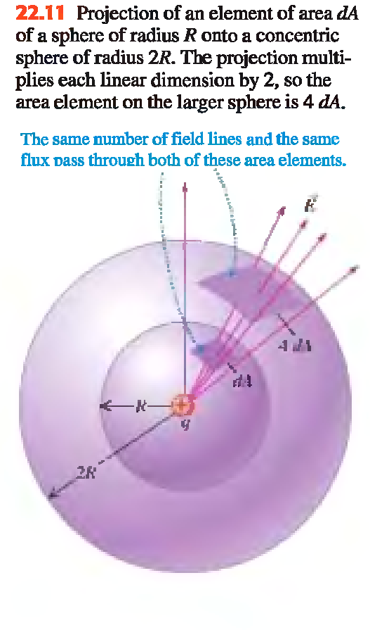

Slide 23
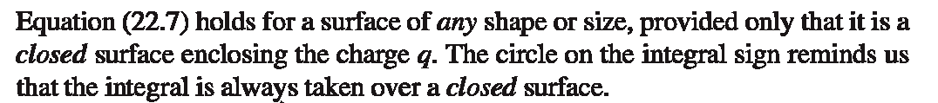
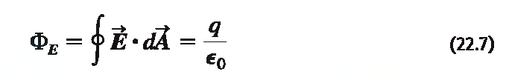
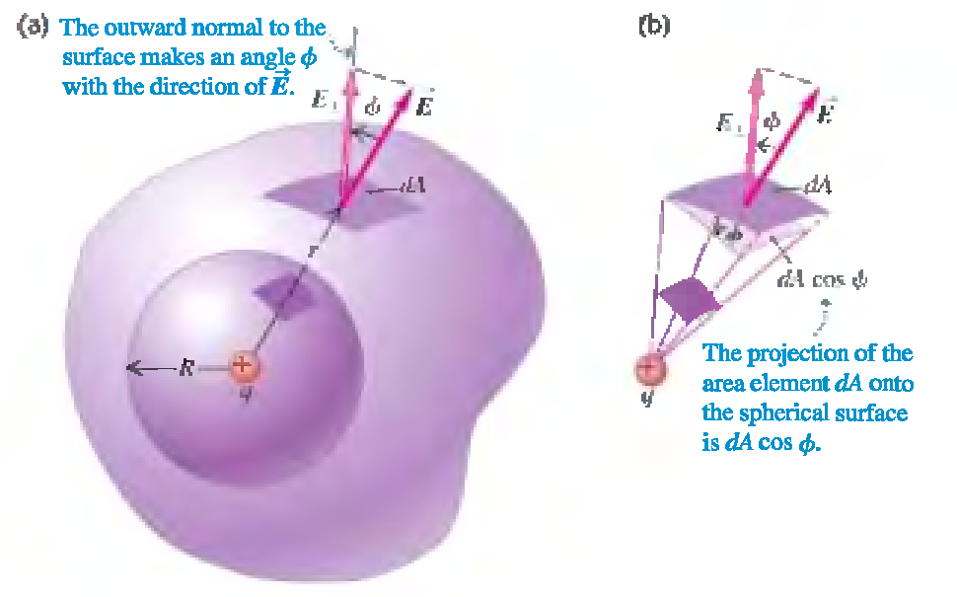
POINT CHARGE INSIDE NON SPHERICAL SURFACE.

Slide 24
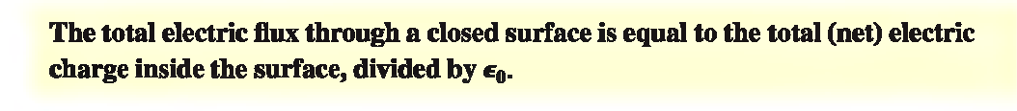

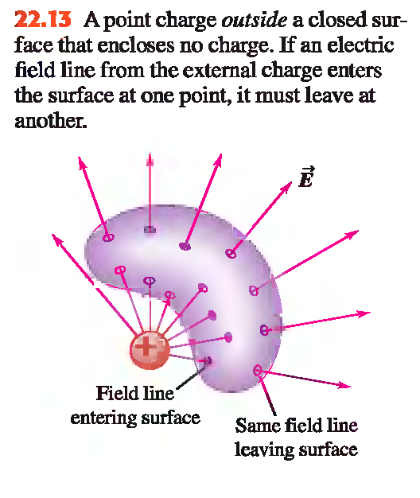
GENERAL FORM OF GAUSS’S LAW

Slide 25
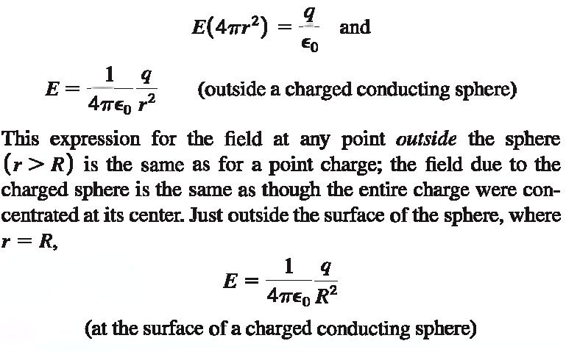
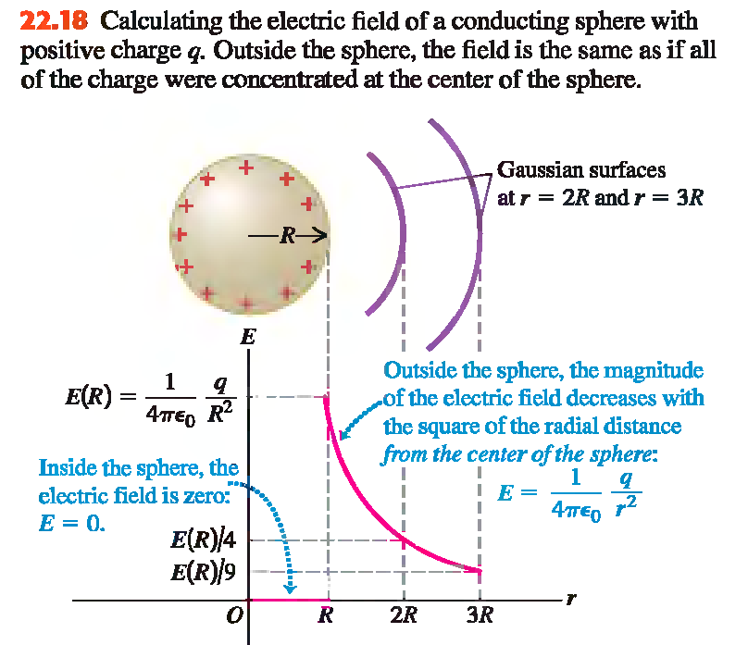
APPLICATION OF GAUSS’S LAW
FIELD OF CHARGE CONDUCTING SPHERE

Slide 26
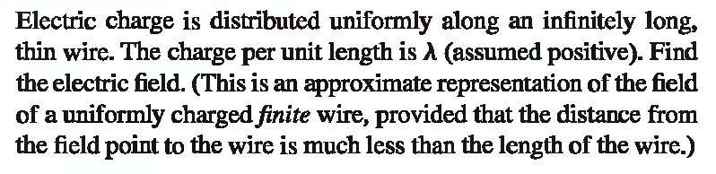
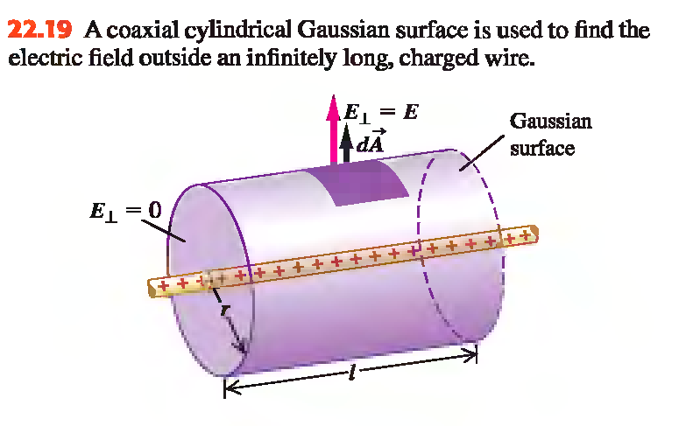
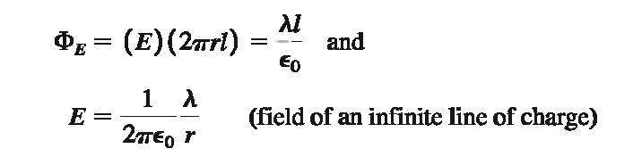
FIELD OF LINE CHARGE
APPLICATION OF GAUSS’S LAW

Slide 27

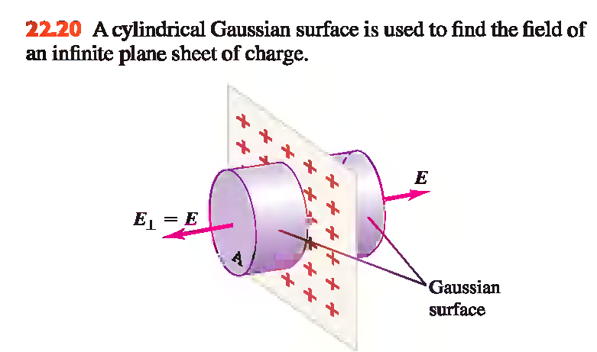
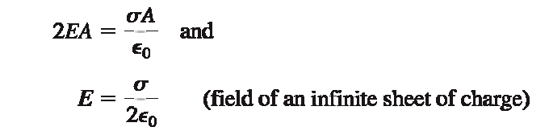
FIELD OF SHEET OF CHARGE
APPLICATION OF GAUSS’S LAW

Slide 28
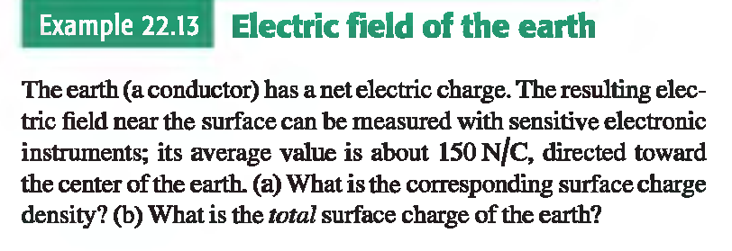
APPLICATION OF GAUSS’S LAW

